Slide 1
Generating noisy speech data from clean data in the frequency domain using Deep Learning Methods
Week – 5
Name: Shashank Shirol
University: Manipal Institute of Technology
Duration of the presentation: ~10 mins.

Slide 2
Tasks to be completed:
Correct the LSD calculation code:
Time Align signals before calculation of LSD.
Normalize signals appropriately.
Incorporate min-max normalization and document the effect on calculation of LSD.
Min Max normalization matches the energy of a an input signal to a reference signal
Study the effect of raising the spectrogram by a certain power.
Train spectrogram raised by a power 2, paint spectrogram by a power 2
Train spectrogram raised by a power 2, paint spectrogram by a power 3
Train spectrogram raised by a power 3, paint spectrogram by a power 2
Train spectrogram raised by a power 3, paint spectrogram by a power 3

Slide 3
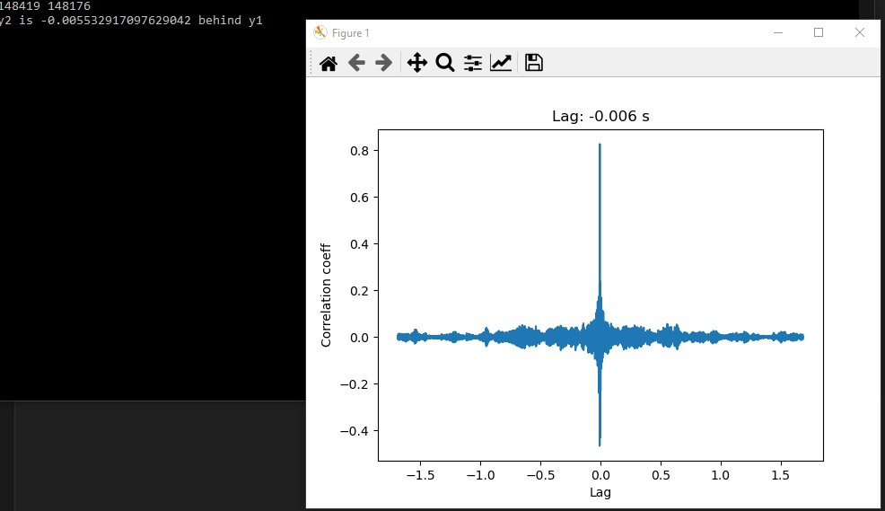
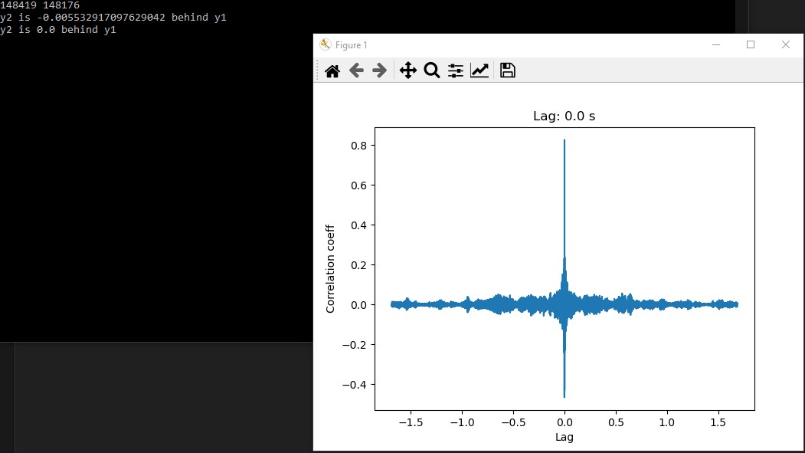
Correcting the LSD calculation code (I):
Time-Alignment is done in three steps:
Pad the smaller signal with 0s to match the length with the bigger signal.
Use cross-correlation to compute the lag.
Use NumPy to correct the lag.
Example:

Slide 4
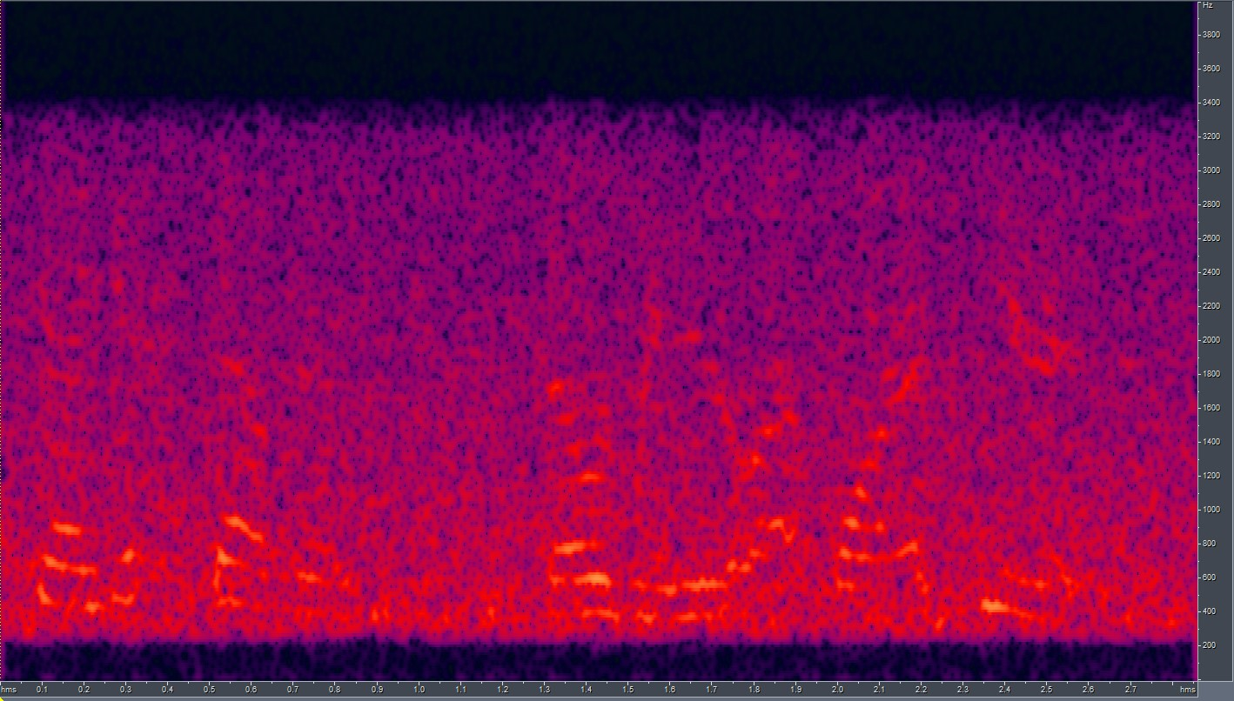
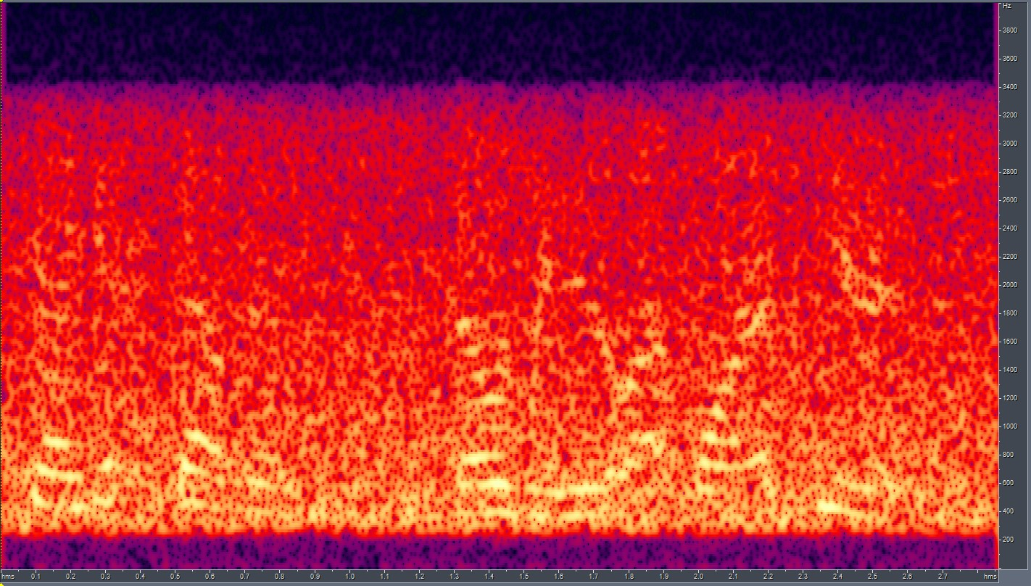
Correcting the LSD calculation code (II):
Normalize signals appropriately so that they are the same average amplitude (volume) . We make use of zero mean and unit STD normalization (zero-unit).
Formula used: signal = (signal - np.mean(signal)) / np.std(signal)
Effect:
Without zero-unit normalization:
LSD (log): 10.1896
LSD (non-log): 1.076
With zero-unit normalization:
LSD(log): 0.4327
LSD(non-log): 0.0035
RATs Noisy
RATs Noisy High Energy

Slide 5
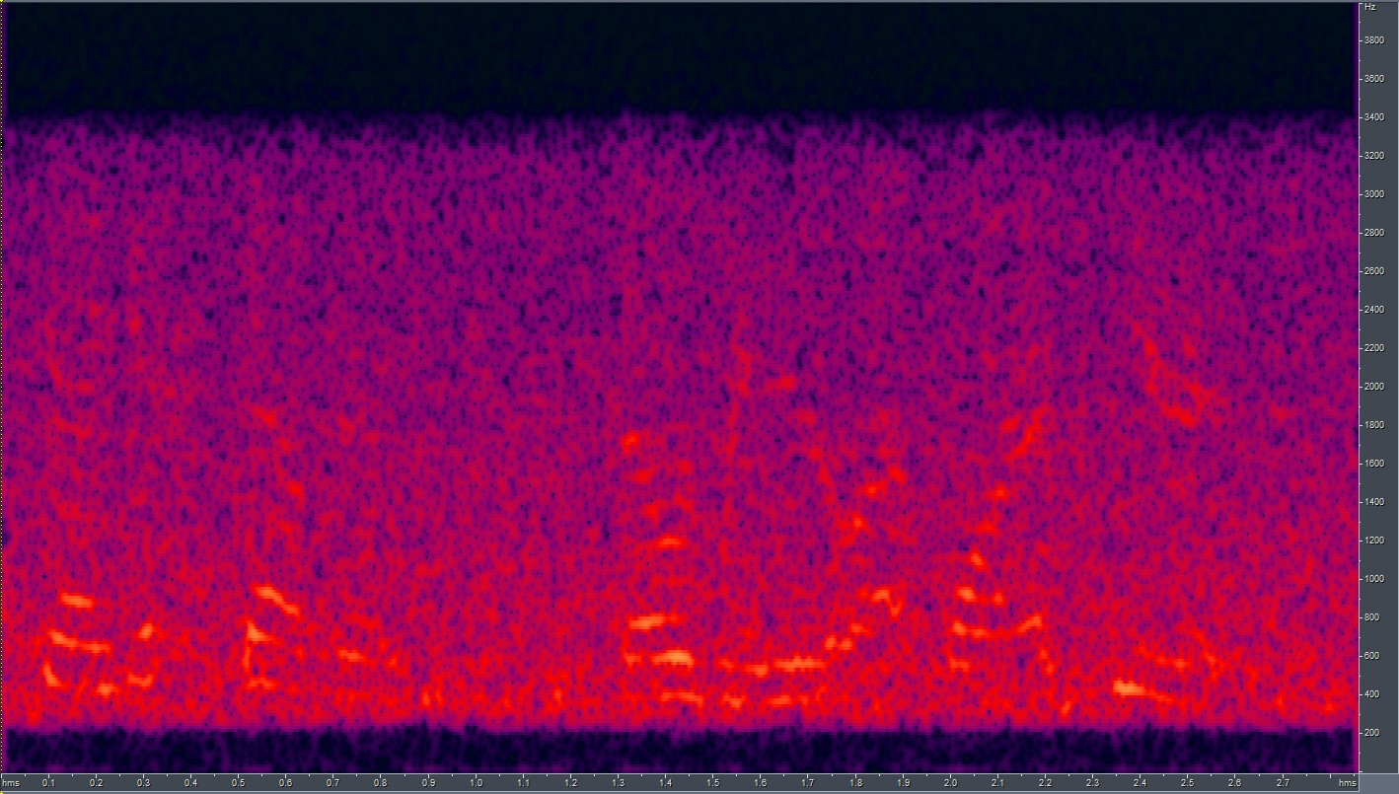
Incorporating min-max normalization and seeing how it affects LSD:
Here, instead of normalizing both signals, we normalize the high energy signal to the low energy one:
Effect:
Only min-max normalization:
LSD (log): 0.3719
LSD (non-log): 0.00008
With zero-unit normalization + min-max normalization:
LSD(log): 0.3087
LSD(non-log): 0.0023
RATs Noisy
RATs Noisy High Energy
RATs Noisy High Energy Normalized

Slide 6
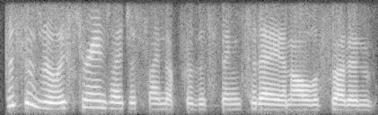
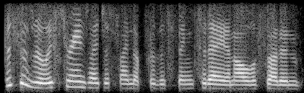
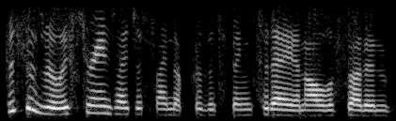
Raising the spectrogram to a power:
Here, before feeding the spectrogram image to SinGAN, we raise it to a power (say, 2 or 3).
Raising the spectrogram to a power changes the way it looks as below:
Training the SinGAN model with these produces new results.
Power = 1 (old)
Power = 2
Power = 3

Slide 7
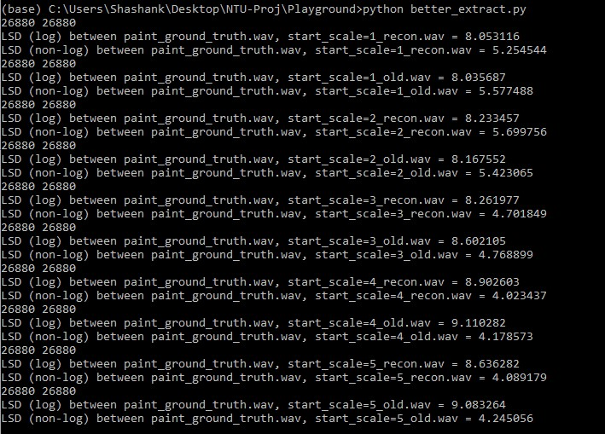

Train spectrogram raised by a power 2, paint spectrogram by a power 2:
The LSD results remain almost unchanged. But the audio reconstructed sounds different.
Scale = 1
GT

Slide 8
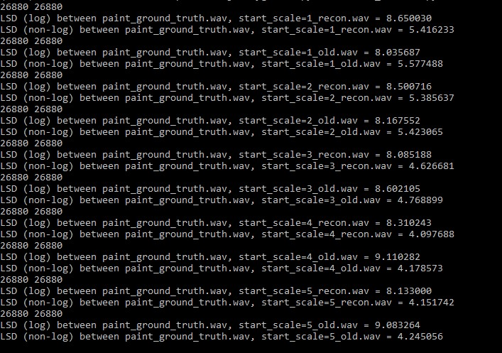
Train spectrogram raised by a power 2, paint spectrogram by a power 3:
In this set up, the output audio sounds similar to the ground truth.
Scale = 3
GT

Slide 9
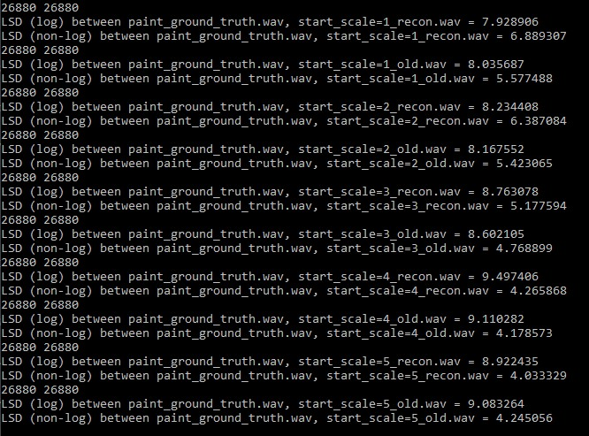
Train spectrogram raised by a power 3, paint spectrogram by a power 2:
In this set up, the output is very lossy. Cannot distinguish what’s being said.
Scale = 1
GT

Slide 10
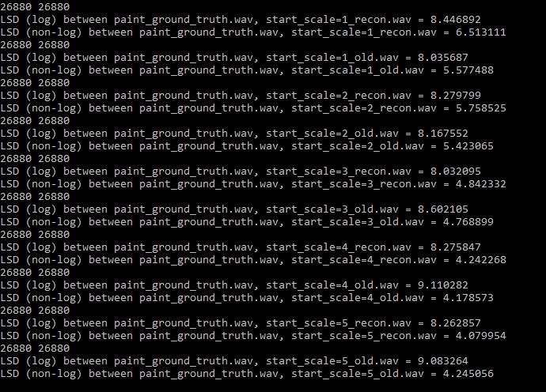
Train spectrogram raised by a power 3, paint spectrogram by a power 3:
In this set up, the output sounds like the ground truth even though the LSD is high.
Scale = 3
GT

Slide 11
End.

